Slide 1
Software Requirements
UNIT-2
Functional and non-functional - user – system –requirement engineering process – feasibility studies – requirements – elicitation – validation and management – software prototyping – prototyping in the software process – rapid prototyping techniques – user interface prototyping -S/W document. Analysis and modeling – data, functional and behavioral models – structured analysis and data dictionary.
Functional and non-functional Requirements
User requirements
System Requirements

Slide 2
Requirements engineering
The process of finding out analyzing, documenting and checking these services and constraints is called requirement engineering.
The requirements themselves are the descriptions of the system services and constraints that are generated during the requirements engineering process.

Slide 3
What is a requirement?
It may range from a high-level abstract statement of a service or of a system constraint to a detailed mathematical functional specification.
This is inevitable as requirements may serve a dual function
May be the basis for a bid for a contract - therefore must be open to interpretation;
May be the basis for the contract itself - therefore must be defined in detail;
Both these statements may be called requirements.

Slide 4
Requirements abstraction (Davis)

Slide 5
Types of requirement
User requirements
Statements in natural language plus diagrams of the services the system provides and its operational constraints. Written for customers.
System requirements
A structured document setting out detailed descriptions of the system’s functions, services and operational constraints. Defines what should be implemented so may be part of a contract between client and contractor.

Slide 6
Definitions and specifications
User requir
ement definition
1. T
he softw
ar
e m
ust pr
o
vide a means of
r
epr
esenting and
1.
accessing e
xternal files cr
ea
ted b
y other tools
.
Syst
em requir
ements specification
1.1 The user should be pr
o
vided with facilities to define the type of
1.2
external files
.
1.2 Each e
xternal file type ma
y ha
v
e an associa
ted tool w
hich ma
y be
1.2
applied to the file
.
1.3 Each e
xternal file type ma
y be r
epr
esented as a specific icon on
1.2
the user’
s displa
y
.
1.4 F
acilities should be pr
o
vided f
or the icon r
epr
esenting an
1.2
e
xternal file type to be defined b
y the user
.
1.5 When a user selects an icon r
epr
esenting an e
xternal file
, the
1.2
effect of that selection is to apply the tool associated with the type of
1.2
the external file to the file represented by the selected icon.
Notes:
Example is creating of MYCOMPUTER icon in operating system.

Slide 7
Example
User requirement definition:
LIBSYS shall keep track of all data of all students in the CU kengeri-campus and CU Main-Campus.
System requirements specification
On making a request for a document from LIBSYS, the requestor shall be presented with , a form that records details of the user and the request made.
LIBSYS request forms shall be stored on the system for Four years from the date of the request.
All LIBSYS .request forms must be indexed by user, by the names of the material requested and by the supplier of the request.
LIBSYS shall maintain a log of all requests that have been made to the system.
For books issuing and late submission the LIBSYS will maintain a record of fine details etc…
Etc Rquirements…..

Slide 8
Requirements readers
Notes:
Fig. shows the types of readers for the user and system requirements. The readers of the user requirements are not usually concerned with how the system will
be implemented and managers who are not interested in the detailed facilities of the system.

Slide 9
Functional and non-functional requirements
Functional requirements
Statements of services the system should provide, how the system should react to particular inputs and how the system should behave in particular situations.
Non-functional requirements
constraints on the services or functions offered by the system such as timing constraints, constraints on the development process, standards, etc.
Domain requirements
Requirements that come from the application domain of the system and that reflect characteristics of that domain.

Slide 10
Requirements completeness and consistency
In principle, requirements should be both complete and consistent.
Complete
They should include descriptions of all facilities required.
Consistent
There should be no conflicts or contradictions in the descriptions of the system facilities.
In practice, it is impossible to produce a complete and consistent requirements document.

Slide 11
Functional requirements
Describe functionality or system services.
Depend on the type of software, expected users and the type of system where the software is used.
Functional user requirements may be high-level statements of what the system should do but functional system requirements should describe the system services in detail.

Slide 12
The LIBSYS system
A library system that provides a single interface to a number of databases of articles in different libraries.
Users can search for, download and print these articles for personal study.

Slide 13
Example projects
PAYROLL SYSTEM
ONLINE SHOPPING
BANKING SYSTEM
ONLINE VOTING SYSTEM
LIBRARY AUTOMATION SYSTEM
STUDENT COURSE REGISTRATION
RAILWAY RESERVATION SYSTEM
Notes:
STUDENT COURSE REGISTRATION:
PROBLEM DEFINITION
To build software that automates the student’s course registration.
This is proposed for automating the student’s course registration. While the student joins any educational institution his admission is made on the basis of his previous records.
The students who wish to the institution must be given with the available course details.
The student is allotted with a seat in the institution based on the marks that he scored in the institution he studied previously. After the confirmation of his joining the student must be given with new identity and records as per the institution.
PAYROLL PROCESSING APPLICATION
PROBLEM DEFENITION
A payroll application is to be developed which is required to perform the following functions:
It must provide a user in employee mode with the details of an employee, which includes his name, department, date of joining and salary.
It must validate an user to enter in administrator mode using password. It must provide a user to enter in administrator mode to view or modify an employee’s details using his employee ID. It must also allow the user to add a new employee and generate the payroll.
AUTOMATED BANKING SYSTEM
PROBLEM DEFENITION
To develop an automated banking system, which is required to perform the following functions:
1.1 The customer logs into the system using card number and pin number. The system checks for validation.
1.2 The system queries the customer for the type of account either fixed deposit or credit account. After getting the type of account the system shows the balance left.
1.3 The system queries the customer for the transaction type either withdrawal or deposit and the required amount. The user enters the amount and the transaction if carries out
LIBRARY MANAGEMENT SYSTEM
PROBLEM DEFENITION
The library management system is software, which automates the job of a librarian.
1.1 The user can inquire about the availability of a book in which he can search by entering the author’s name or by entering the title of the book.
1.2 The user can borrow a book. He must provide the username and the card number, which is unique and confidential to each user. By confirming the authenticity of a user, the library management system provides information about the number of books already borrowed by the user and by referring to the database whether the user can borrow books or not. The library management system allows the user to enter the title and the author of the book and hence issues the book if it is available.
1.3 By entering the user details and the book details the user can return the borrowed book.
RAILWAY RESERVATION SYSTEM
PROBLEM DEFENITION
Ticket reservation system for railway department has to be developed.
The system developed should contain the following features
The system should contain the following features
Search for information about the train by means of train number and destination
While displaying information about the train it has to provide availability of seats in different classes (first class , second class, a.c)
While reserving tickets the system obtain following information from the user
Passenger Name, Sex, Age, Address.
Credit Card Number, Bank Name.
Class through passenger is going to travel i.e first class/second class/A.C
Train number, Train name, Date of Journey and number of tickets to be booked.
Based on the availability of tickets, the ticket has to be issued. The ticket issued should contain the following information –PNR number, train no, train name, date of journey, class, number of passengers, sex, age and departure time.
Cancellation of booked tickets should be available.
TRADING SYSTEM
PROBLEM DEFENITION
The requirement to be developed is an Trading system which is required to perform the following functions.
1.1 It should allow user to view stock details of each part which must include part number, part name, demand per day, setup cost, holding cost, lead time, cycle time, EOQ, order amount and availability.
It should allow the user to take parts required for production.
It should allow the user to order required units of production.
It should allow the user to add a new part to the stock.

Slide 14
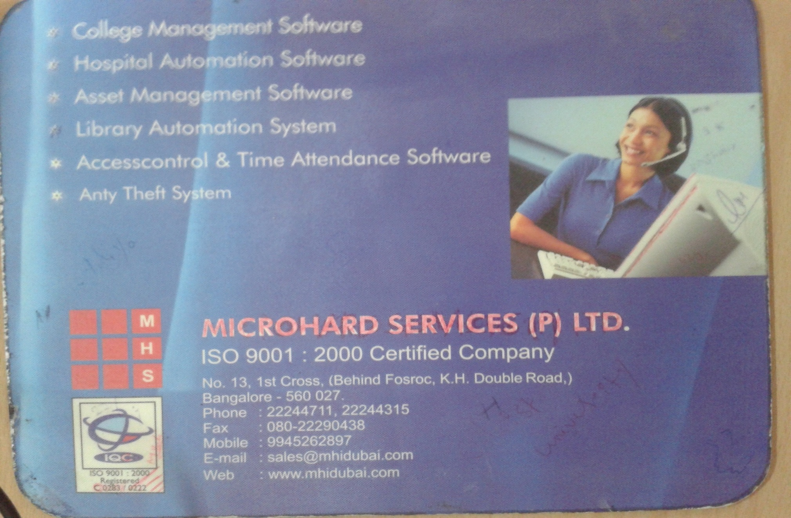
Example projects

Slide 15
Examples of functional requirements
The user shall be able to search either all of the initial set of databases or select a subset from it.
The system shall provide appropriate viewers for the user to read documents in the document store.
Every order shall be allocated a unique identifier (ORDER_ID) which the user shall be able to copy to the account’s permanent storage area.

Slide 16
Non-functional requirements
These define system properties and constraints e.g. reliability, response time and storage requirements. Constraints are I/O device capability, system representations, etc.
Process requirements may also be specified mandating a particular CASE system, programming language or development method.
Non-functional requirements may be more critical than functional requirements. If these are not met, the system is useless.

Slide 17
Non-functional classifications
Product requirements
Requirements which specify that the delivered product must behave in a particular way e.g. execution speed, reliability, etc.
Organisational requirements
Requirements which are a consequence of organisational policies and procedures e.g. process standards used, implementation requirements, etc.
External requirements
Requirements which arise from factors which are external to the system and its development process e.g. interoperability requirements, legislative requirements, etc.

Slide 18
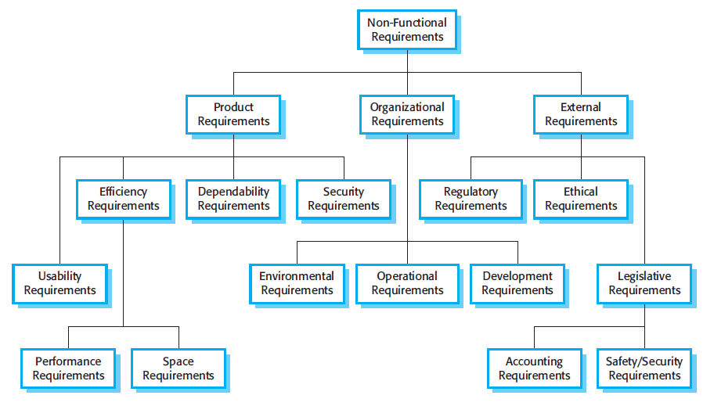
Non-functional requirement types
Notes:
Fig. is a classification of non-functional requirements. You can see from this diagram that the non-functional requirements may come from required characteristics
of the software (product requirements), the organization developing the software (organizational requirements) or from external sources.
1. Product requirements
These requirements specify product behavior.
Examples include
1. Performance requirements - how fast the system must execute and how much memory it requires.
2. Reliability requirements - that set out the acceptable failure rate;
3. Portability requirement and
4. Usability requirements.
2. Organizational requirements
These requirements are derived from policies and procedures in the customer's and developer's organization.
Examples include process standards that must be used.
Implementation requirements - such as the programming language or design method used.
Delivery requirements - that specify when the product and its documentation are to be delivered.
3. External requirements
This broad heading covers all requirements that are derived from factors external to the system and its development process. These may include
Interoperability requirements - that define how the system interacts with systems in other organizations.
Legislative requirements - that must be followed to ensure that the system operates within the law and ethical requirements.
Ethical requirements - are requirements placed on a system to ensure that it will be acceptable to its users and the general public.
A common problem with non-functional requirements is that they can be difficult to verify. Users or customers often state these requirements as general goals such as
ease of use, the ability of the system to recover from failure or rapid user response. A non-functional requirement should be expressed quantitatively using metrics
that can be objectively-tested as followed.

Slide 19
Non-functional requirements examples
Product requirement
The user interface for LIBSYS shall be implemented as simple HTML without frames or Java applets.
Organisational requirement
The system development process and deliverable documents shall conform to the process and deliverables defined in XYZCo-SP-STAN-95.
External requirement
The system shall not disclose any personal information about customers apart from their name and reference number to the operators of the system.

Slide 20
Requirements measures

Slide 21
Domain requirements
Derived from the application domain and describe system characteristics and features that reflect the domain.
Domain requirements be new functional requirements, constraints on existing requirements or define specific computations.
If domain requirements are not satisfied, the system may be unworkable.

Slide 22
Domain requirements problems
Understandability
Requirements are expressed in the language of the application domain;
This is often not understood by software engineers developing the system.
Implicitness
Domain specialists understand the area so well that they do not think of making the domain requirements explicit.

Slide 23
User requirements
Should describe functional and non-functional requirements in such a way that they are understandable by system users who don’t have detailed technical knowledge.
User requirements are defined using natural language, tables and diagrams as these can be understood by all users.

Slide 24
System requirements
More detailed specifications of system functions, services and constraints than user requirements.
They are intended to be a basis for designing the system.
They may be incorporated into the system contract.
System requirements may be defined or illustrated using system models.

Slide 25
Guidelines for writing requirements
Invent a standard format and use it for all requirements.
Use language in a consistent way. Use shall for mandatory requirements, should for desirable requirements.
Use text highlighting to identify key parts of the requirement.
Avoid the use of computer jargon.

Slide 26
Problems with natural language
Lack of clarity
Precision is difficult without making the document difficult to read.
Requirements confusion
Functional and non-functional requirements tend to be mixed-up.
Requirements amalgamation(consolidation)
Several different requirements may be expressed together.

Slide 27
Alternatives to NL specification

Slide 28
Structured language specifications
The freedom of the requirements writer is limited by a predefined template for requirements.
All requirements are written in a standard way.
The terminology used in the description may be limited.
The advantage is that the most of the expressiveness of natural language is maintained but a degree of uniformity is imposed on the specification.

Slide 29
Tabular specification
Used to supplement natural language.
Particularly useful when you have to define a number of possible alternative courses of action.

Slide 30
Graphical models
Graphical models are most useful when you need to show how state changes or where you need to describe a sequence of actions.

Slide 31
Sequence diagrams
These show the sequence of events that take place during some user interaction with a system.
You read them from top to bottom to see the order of the actions that take place.
Cash withdrawal from an ATM
Validate card;
Handle request;
Complete transaction.

Slide 32
Sequence diagram of ATM withdrawal

Slide 33
The requirements document
The requirements document is the official statement of what is required of the system developers.
Should include both a definition of user requirements and a specification of the system requirements.
It is NOT a design document. As far as possible, it should set of WHAT the system should do rather than HOW it should do it
What is an SRS ?
A complete specification of what the proposed system should do!

Slide 34
Characteristics of an SRS
Correct
Complete
Unambiguous
Consistent
Verifiable
Traceable
Modifiable
Ranked for importance and/or stability

Slide 35
Characteristics…
Correctness
Each requirement accurately represents some desired feature in the final system
Completeness
All desired features/characteristics specified
Hardest to satisfy
Completeness and correctness strongly related
Unambiguous
Each req has exactly one meaning
Without this errors will creep in
Important as natural languages often used

Slide 36
Characteristics…
Verifiability
There must exist a cost effective way of checking if sw satisfies requirements
Consistent
two requirements don’t contradict each other
Traceable
The origin of the req, and how the req relates to software elements can be determined
Ranked for importance/stability
Needed for prioritizing in construction
To reduce risks due to changing requirements

Slide 37
Requirements document structure
Preface
Introduction
Glossary
User requirements definition
System architecture
System requirements specification
System models
System evolution
Appendices
Index

Slide 38
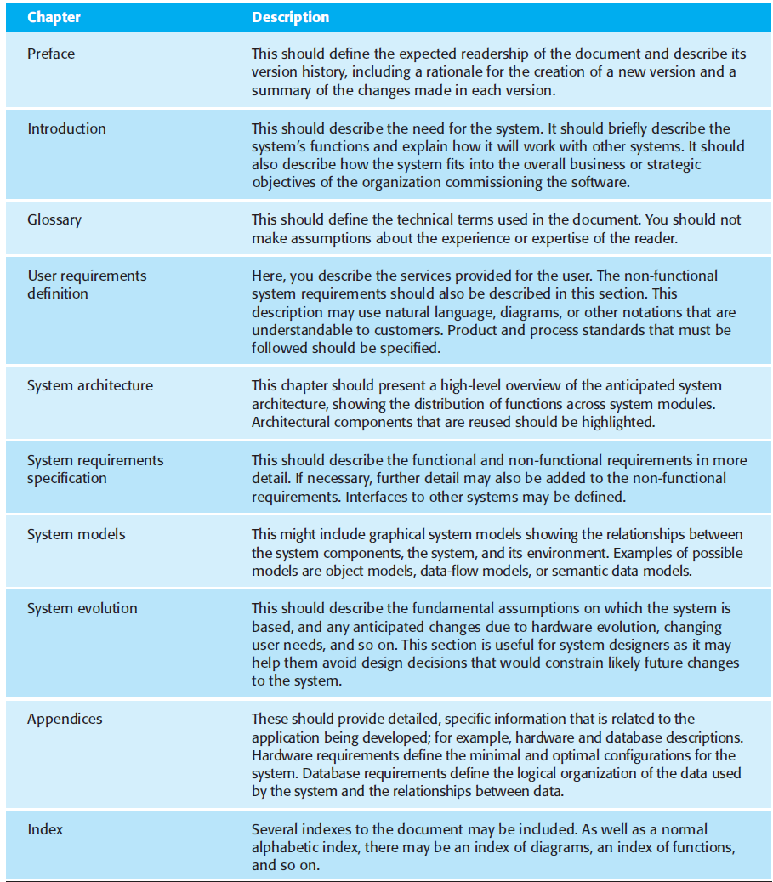

Slide 39
Activity
To learn aspects of previous semester project, try to Re-define SRS (Previous semester project).
Aim: To know the concepts of project and define SRS according to SDLC
Input: Current project
Conclusion: Define SRS of current project.

